Slide 1


Slide 2

EXECUTIVE OVERVIEW
BRCC turns resilience into a management operating system
UNDERSTAND
PROTECT
RECOVER
Unify financial and operating signals into one executive view: KPIs, receivables, profitability, cash, customer health and trends.
Identify risk, leakage, exposure and early warnings with confidence, evidence, ownership and governance.
Convert issues into managed recovery cases, approved actions, follow-up and verified realized value.
BRCC / Digi Technology
02

Slide 3
OPERATING MODEL
From business signal to verified value
BUSINESS
SIGNALS
RISK &
INSIGHT
MANAGEMENT
DECISION
RECOVERY
ACTION
REALIZED
VALUE
›
›
›
›
A closed-loop resilience lifecycle
BRCC connects data, evidence, decision, ownership and outcome — while keeping management approval at the center.
BRCC / Digi Technology
03

Slide 4
EXECUTIVE COMMAND CENTER
One view of business resilience
0–100
30/60/90
5
1
Resilience score
Forecast horizons
Alert dimensions
Management cockpit
EXECUTIVE CONTEXT
ACTION ORIENTATION
KPIs, exposure, confidence, data freshness and drill-down evidence are presented together.
Management can move from insight to decision, owner, due date, recovery and verification.
BRCC / Digi Technology
04

Slide 5
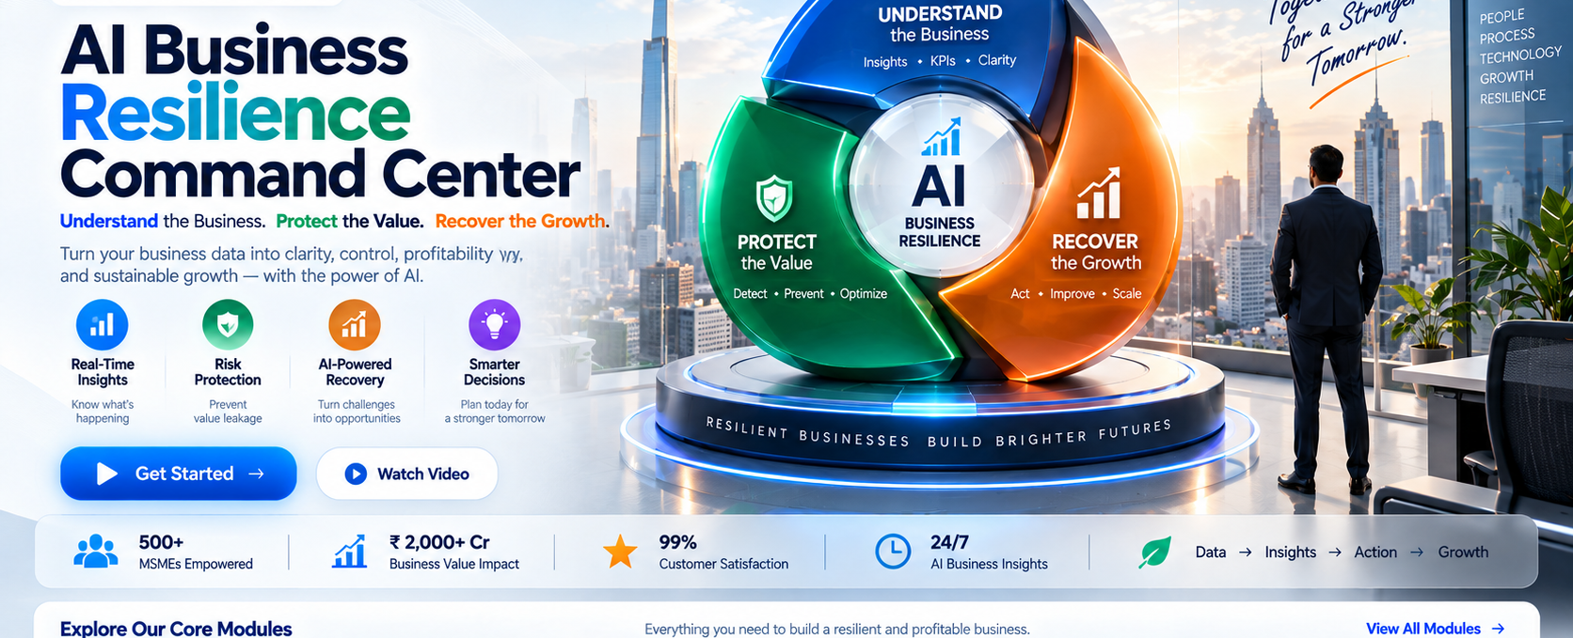
PRODUCT EXPERIENCE
Approved BRCC visual language
BRCC / Digi Technology
05

Slide 6
UNDERSTAND
See the business before reacting to it
FINANCIAL HEALTH
BUSINESS HEALTH
MANAGEMENT CONTEXT
Sales & gross profit
Receivables & payables
Cash / bank
Expenses & margin
Customer health
Business KPIs
Company / branch scope
Trend visibility
Data freshness
Drill-down traceability
Exceptions
Evidence & confidence
BRCC / Digi Technology
06

Slide 7
PROTECT
Detect what can damage value
DETECT
EXCEPTION
QUANTIFY
EXPOSURE
ASSESS
CONFIDENCE
PRIORITIZE
RISK
›
›
›
WHAT MANAGEMENT SEES
WHY IT MATTERS
Severity, financial exposure, confidence, source evidence and accountable owner.
Risks become visible before they turn into uncontrolled financial or operational impact.
BRCC / Digi Technology
07

Slide 8
RECOVER
Make recovery measurable
CREATE
CASE
ASSIGN
OWNER
TRACK
ACTION
VERIFY
OUTCOME
REALIZE
VALUE
›
›
›
›
Recovery is not an alert. It is a governed lifecycle.
Target value, action status, ownership, due dates, evidence and realized benefit stay traceable.
BRCC / Digi Technology
08

Slide 9
AI INTELLIGENCE
Decision support — with human control
EXPLAIN
RECOMMEND
GOVERN
Use business evidence and context to explain what may be driving an issue.
Generate management-oriented recommendations with impact and confidence context.
Apply confidence thresholds, approvals and external-data guardrails through enterprise configuration.
BRCC / Digi Technology
09

Slide 10
PREDICTIVE INTELLIGENCE
Move from rear-view reporting to early warning
30 DAYS
60 DAYS
90 DAYS
Near-term outlook
Mid-term outlook
Forward outlook
FORECAST
EARLY WARNING
Projected cash, collections, sales run-rate and receivable exposure.
Liquidity gaps, sales decline, margin deterioration and high-risk customer accounts.
BRCC / Digi Technology
10

Slide 11
SCENARIO SIMULATOR
Test management choices before committing
CHANGE
COMPARE
DECIDE
Collections
Sales growth / decline
Gross margin
Expenses
Before vs after
Cash impact
Gross-profit impact
Outstanding & 90+ exposure
Collection Push
Margin Recovery
Cost Optimization
Downturn Stress
Scenario outputs are modeled decision support; BRCC does not automatically post financial actions to the ERP.
BRCC / Digi Technology
11

Slide 12
MANAGEMENT WAR ROOM
A single queue for important decisions
UNIFY
PRIORITIES
REVIEW
EVIDENCE
APPROVE /
REJECT
ASSIGN
OWNER
CLOSE THE
LOOP
›
›
›
›
INPUTS
CONTROL
Protect risks • AI recommendations • Predictive warnings • Recovery actions • Scenarios
Human approval • Due date • Ownership • Status • Recovery target • Realized value
BRCC / Digi Technology
12

Slide 13
VALUE REALIZATION
Connect resilience to financial impact
DETECTED
EXPOSURE
PROTECTED /
RECOVERED
HUMAN
VERIFICATION
REALIZED
BENEFIT
ROI
›
›
›
›
ROI = (Verified Realized Value − Annual BRCC Cost) / Annual BRCC Cost × 100
Realized value requires a human verification event; BRCC does not auto-certify financial benefit.
BRCC / Digi Technology
13

Slide 14
WORKING CAPITAL
See where operating value is constrained
AR
INV
AP
CASH
Receivables
Inventory
Payables
Liquidity
BRCC brings these signals together with profitability and operational risk so management can see pressure points in context.
BRCC / Digi Technology
14

Slide 15
INTEGRATION HUB
Connect BRCC to the systems you already use
SQL / CUSTOM ERP
REST / API
FILE BRIDGE
Configurable SQL connectivity, entity routing, field mapping and incremental checkpoints.
Canonical JSON endpoints with bearer / API-key support and configurable mappings.
CSV import path; Excel can export to CSV and use the same mapping and validation engine.
Connector catalog also includes BUSY, Tally/TallyPrime and Zoho Books paths; compatibility depends on source structure, permissions and configuration.
BRCC / Digi Technology
15

Slide 16
DATA CERTIFICATION
Trust the data before trusting the decision
SOURCE
ERP
RECONCILE
TOLERANCE
CHECK
CERTIFY
AUDIT
EVIDENCE
›
›
›
›
CERTIFIED
REVIEW
FAILED
Within accepted reconciliation tolerance.
Requires management / technical review.
Material reconciliation issue remains.
BRCC / Digi Technology
16

Slide 17
GOVERNANCE
Enterprise control without slowing management
ROLE & SCOPE
AUDITABILITY
GUARDRAILS
Company / branch-bound access
Role permissions
Admin-controlled user access
Security audit
Decision audit
Configuration audit
Ownership & source references
Feature governance
Threshold configuration
AI approval rules
API scopes & rate limits
BRCC / Digi Technology
17

Slide 18
NOTIFICATIONS
Escalate what matters — with context
01
02
03
04
05
Severity
Exposure
Confidence
Owner / due
SLA level
In-app delivery is ready. Email / SMS / WhatsApp delivery requires a configured provider.
BRCC / Digi Technology
18

Slide 19
EXECUTIVE REPORTING
From daily management to board visibility
DAILY
WEEKLY
MONTHLY
CEO / CFO Daily Brief
Live executive snapshot
Priorities & exposure
Management trends
Risks & recovery
AI insights with context
Board-oriented performance
Exposure
Realized value & ROI
PDF and native XLSX export are implemented; scheduled delivery depends on external email-provider configuration.
BRCC / Digi Technology
19

Slide 20
GROUP COMMAND CENTER
See resilience across multiple companies
CONSOLIDATED HEALTH
CROSS-COMPANY RISK
GROUP VALUE
Group Resilience / Understand / Protect / Recover scores and executive snapshots.
Top risks, financial exposure and branch comparison across companies.
Recovery target, recovered value, realized value, annual BRCC cost and group ROI.
BRCC / Digi Technology
20

Slide 21
WEB & API
Built for browser access and controlled integration
WEB APPLICATION
EXTERNAL API
Desktop and laptop access through a supported browser after hosting and production setup.
Management workflows remain centralized in the BRCC web experience.
Versioned /api/v1 endpoints with API-key authentication, scopes, rate limits and optional IP allow-list.
BRCC / Digi Technology
21

Slide 22
SECURITY
Production authentication and controlled access
WEB AUTHENTICATION
USER ADMIN
API SECURITY
Cookie-based login
Password hashing
Lockout controls
Password reset
Create / enable / disable / unlock
Company access
Role assignment
Audit
SHA-256 key hashing
Scopes
Rate limits
IP allow-list
Request audit
MFA persistence is included as a foundation; external OTP delivery requires provider configuration and hardening.
BRCC / Digi Technology
22

Slide 23
RELIABILITY & DR
Operate with visibility into platform readiness
HEALTH
BACKUP
INCIDENT
RESTORE TEST
DR DRILL
›
›
›
›
MONITOR
VALIDATE
Health endpoints, heartbeat, database size, blocking / long-running activity, errors and integration failures.
Backup recency, RPO/RTO, incident register, restore-test and DR-drill evidence.
BRCC / Digi Technology
23

Slide 24
ARCHITECTURE
Enterprise structure designed for maintainability
WEB
APPLICATION
INFRASTRUCTURE
DOMAIN
ASP.NET Core MVC
Controllers
Razor Views
Presentation layer
Services
Use cases
Business workflows
Contracts
SQL Server access
Integrations
Persistence
External services
Core models
Business concepts
Shared enterprise rules
BRCC / Digi Technology
24

Slide 25
IMPLEMENTATION
A controlled path from source system to live use
CONFIGURE
ENVIRONMENT
CONNECT
SOURCE DATA
MAP &
RECONCILE
UAT &
SIGN-OFF
PRODUCTION
VALIDATION
›
›
›
›
Recommended path: establish scope and access rules → certify source data → complete UAT evidence → pass security, infrastructure and release gates.
BRCC / Digi Technology
25

Slide 26
RELEASE READINESS
BRCC Enterprise Edition V1.0.0
V1.0.0
ENTERPRISE SCOPE
Executive command center • Understand / Protect / Recover • AI & predictive intelligence • scenarios • War Room • ROI • integrations • governance • reporting • multi-company • reliability • API • authentication • UAT • release engineering
Release Candidate / Production-Freeze Candidate
Production status remains environment-dependent and requires final security, data certification, UAT and release validation.
BRCC / Digi Technology
26

Slide 27
WHY BRCC
A management system for resilience — not another dashboard
ONE VIEW
ONE CONTROL LOOP
ONE GOVERNANCE MODEL
Financial health, operating risk, predictive warnings, decisions and recovery in one command center.
Evidence → decision → owner → action → verification → realized value.
Human approval, role control, auditability, data certification and configurable guardrails.
BRCC / Digi Technology
27

Slide 28
BRCC
Business Resilience
Command Center
Ready to see resilience in one command center?
Pranaw Kumar Solanky
9953314420 • 9312536185
digitech.services
solanky.digitech@gmail.com
Digi Technology

