Slide 1


BUSINESS HEALTH COMMAND CENTER
BHCC
Business Health
Command Center
Business visibility.
Focused management action.
BHCC / Digi Technology
01
Notes:
Source: supplied BHCC software, JN_ARORA_BHCC_FIX30_COMMON_PARTY_FULL.zip. Product descriptions reflect source modules and prior project screenshots, not a certification of the current deployment.

Slide 2
PRODUCT OVERVIEW
A clearer view of the business
What is happening?
Why does it matter?
What comes next?
Review health across sales, customers, collections and operations.
Examine the issue, its context and known financial exposure.
Set priorities and follow up on the work that needs attention.
BHCC / Digi Technology
02
Notes:
Source: supplied BHCC software, JN_ARORA_BHCC_FIX30_COMMON_PARTY_FULL.zip. Product descriptions reflect source modules and prior project screenshots, not a certification of the current deployment.

Slide 3
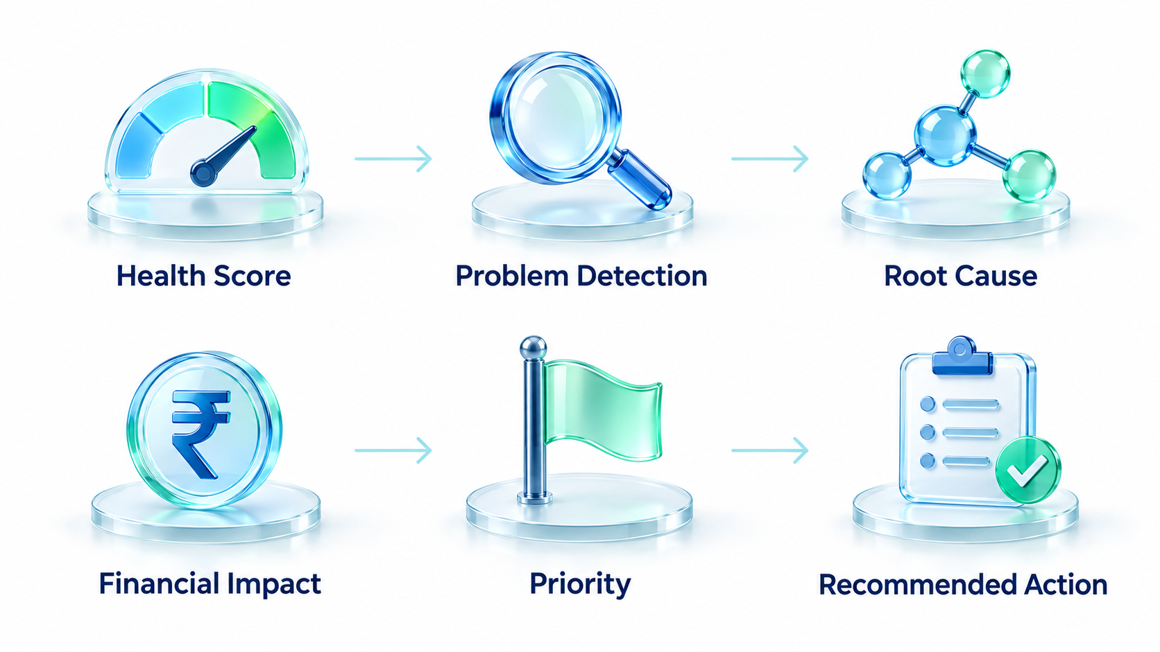
PRODUCT OVERVIEW
The BHCC decision journey
BHCC / Digi Technology
03
Notes:
Conceptual workflow infographic based on the user-approved BHCC sequence: Business Health Score, Problem Detection, Reason, Financial Impact, Priority, Recommended Action.

Slide 4
BUSINESS VALUE
A shared workspace for management
01
Business owners
A concise view of business health and current priorities.
02
Finance teams
Receivables, collections and cash-related issues in context.
03
Sales and operations
Customer performance, inventory and assigned work.
BHCC / Digi Technology
04
Notes:
Source: supplied BHCC software, JN_ARORA_BHCC_FIX30_COMMON_PARTY_FULL.zip. Product descriptions reflect source modules and prior project screenshots, not a certification of the current deployment.

Slide 5
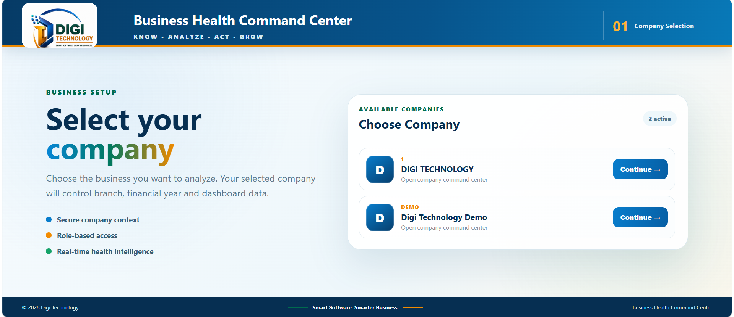
PROJECT PREVIEW
Company selection
Project preview: company selection screen from an earlier BHCC build.
BHCC / Digi Technology
05
Notes:
Source: supplied BHCC software, JN_ARORA_BHCC_FIX30_COMMON_PARTY_FULL.zip. Product descriptions reflect source modules and prior project screenshots, not a certification of the current deployment. Screenshot: 26b2d302-d70d-4533-a255-852a14615d3d.png.

Slide 6
BUSINESS HEALTH
Business Health Score
0–100
Category health contributes to the overall score.
The score helps direct attention to the underlying KPIs and detected problems.
Read it alongside data freshness and coverage.
A summary for the management review
BHCC / Digi Technology
06
Notes:
Source: supplied BHCC software, JN_ARORA_BHCC_FIX30_COMMON_PARTY_FULL.zip. Product descriptions reflect source modules and prior project screenshots, not a certification of the current deployment.

Slide 7
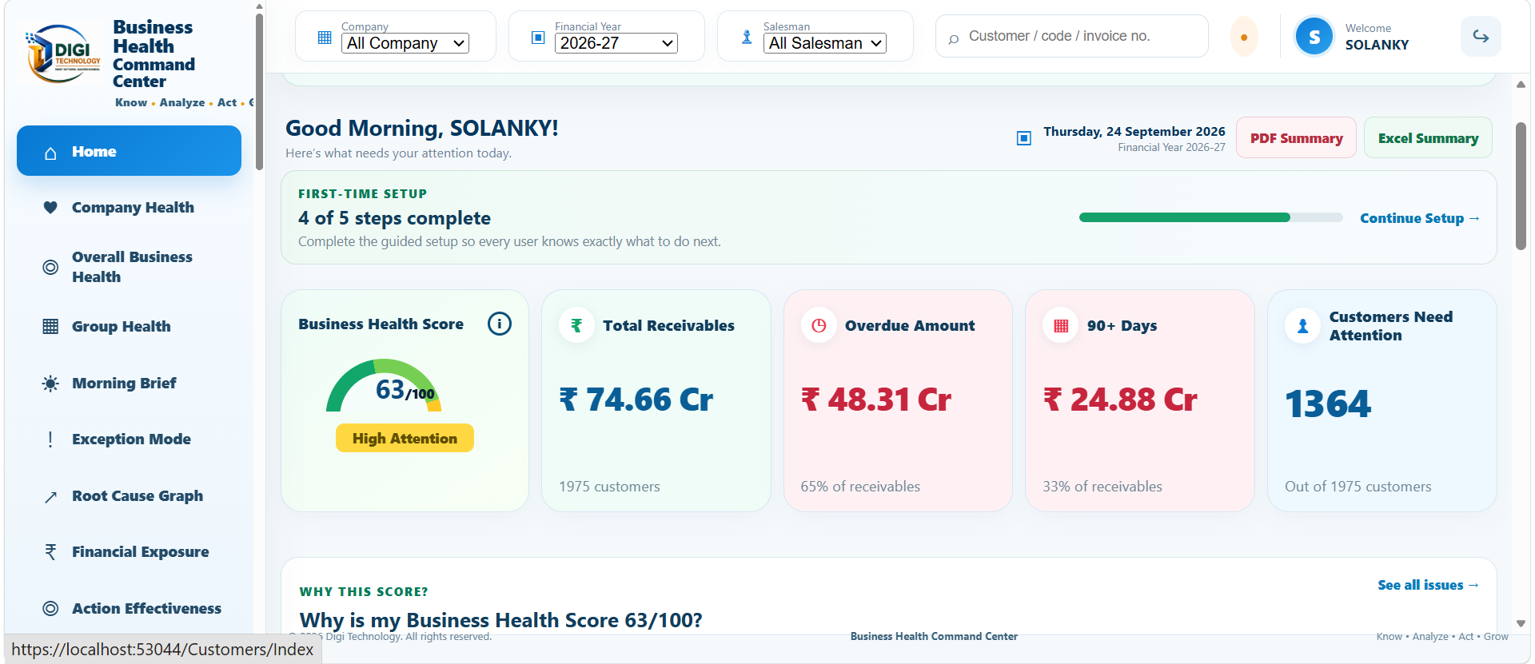
PROJECT PREVIEW
BHCC dashboard
Project preview: earlier build. Displayed figures are historical, not current results.
BHCC / Digi Technology
07
Notes:
Source: supplied BHCC software, JN_ARORA_BHCC_FIX30_COMMON_PARTY_FULL.zip. Product descriptions reflect source modules and prior project screenshots, not a certification of the current deployment. Screenshot a4adfb8e-b1a4-4390-bb15-fbdc76e5a50e.png.

Slide 8
BUSINESS HEALTH
Business health coverage
Revenue
Operations
Performance
Sales health
Customer health
Receivables
Inventory health
Cash flow
Payables
Profitability
Working capital
Management trends
BHCC / Digi Technology
08
Notes:
Source: supplied BHCC software, JN_ARORA_BHCC_FIX30_COMMON_PARTY_FULL.zip. Product descriptions reflect source modules and prior project screenshots, not a certification of the current deployment.

Slide 9
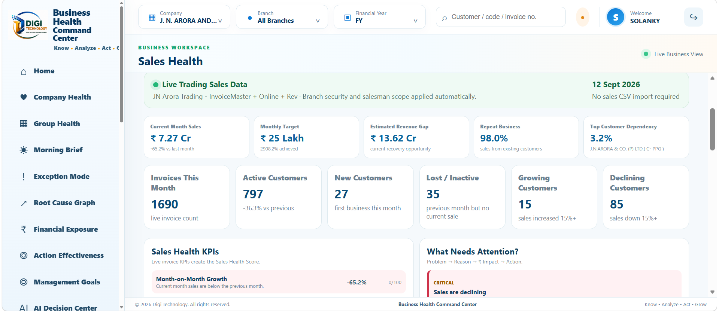
PROJECT PREVIEW
Sales health
Project preview: sales KPIs, customer activity and areas needing attention.
BHCC / Digi Technology
09
Notes:
Source: supplied BHCC software, JN_ARORA_BHCC_FIX30_COMMON_PARTY_FULL.zip. Product descriptions reflect source modules and prior project screenshots, not a certification of the current deployment. Historical screenshot 80ba1799-ce90-458b-8f0a-cd85c31d0f1f.png, 12 September 2026. Values are not current results.

Slide 10
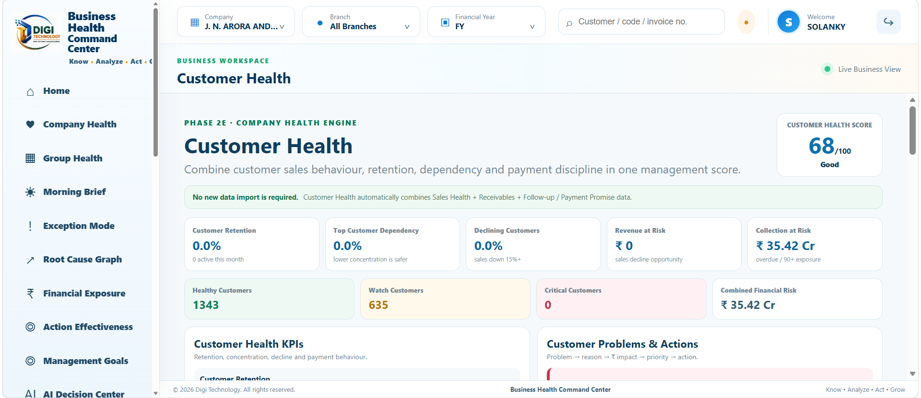
PROJECT PREVIEW
Customer health
Project preview: customer health indicators and collection exposure.
BHCC / Digi Technology
10
Notes:
Source: supplied BHCC software, JN_ARORA_BHCC_FIX30_COMMON_PARTY_FULL.zip. Product descriptions reflect source modules and prior project screenshots, not a certification of the current deployment. Historical screenshot d6727173-5a55-4c12-93a0-9da4a1798696.png. Figures are historical and not audited claims.

Slide 11
FINANCE WORKSPACE
Receivables and collections
01
Outstanding balances
Review the amount due and the customer-level position.
02
Overdue exposure
Identify overdue balances and accounts needing attention.
03
Collection follow-up
Connect the issue with a recorded next action.
BHCC / Digi Technology
11
Notes:
Source: supplied BHCC software, JN_ARORA_BHCC_FIX30_COMMON_PARTY_FULL.zip. Product descriptions reflect source modules and prior project screenshots, not a certification of the current deployment.

Slide 12
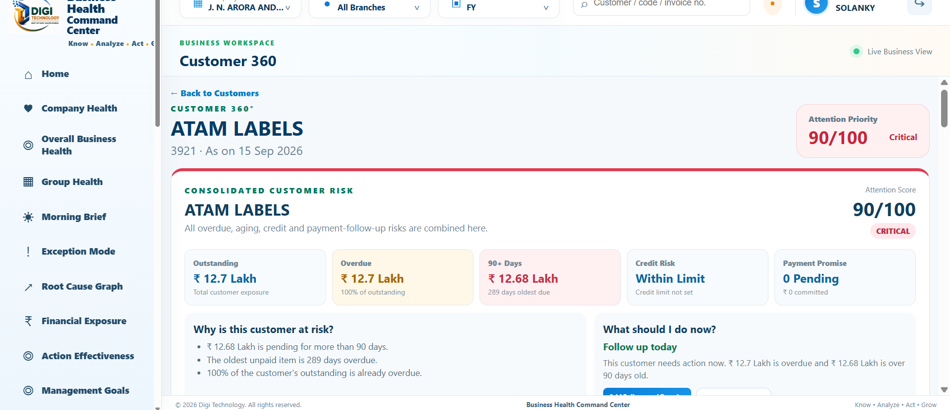
PROJECT PREVIEW
Customer 360
Project preview: one customer’s balance, risk and follow-up context.
BHCC / Digi Technology
12
Notes:
Source: supplied BHCC software, JN_ARORA_BHCC_FIX30_COMMON_PARTY_FULL.zip. Product descriptions reflect source modules and prior project screenshots, not a certification of the current deployment. Historical screenshot bc3e3925-e03f-475f-b3a4-5d1a6979fdf8.png.

Slide 13
ACTION MANAGEMENT
A structured follow-up record
Conversation
Payment promise
Next action
Call note
Customer response
Follow-up history
Promise amount
Promise date
Broken-promise review
Assigned employee
Next follow-up date
Current status
BHCC / Digi Technology
13
Notes:
Source: supplied BHCC software, JN_ARORA_BHCC_FIX30_COMMON_PARTY_FULL.zip. Product descriptions reflect source modules and prior project screenshots, not a certification of the current deployment.

Slide 14
ACTION MANAGEMENT
Today’s Work
01
Review priorities
See assigned work and overdue items that need attention.
02
Take action
Complete, snooze or reassign work as appropriate.
03
Record the outcome
Update the task or payment promise so the next review has context.
BHCC / Digi Technology
14
Notes:
Source: supplied BHCC software, JN_ARORA_BHCC_FIX30_COMMON_PARTY_FULL.zip. Product descriptions reflect source modules and prior project screenshots, not a certification of the current deployment.

Slide 15

OPERATIONS
Inventory and working capital
Stock ties up business funds
Review inventory health alongside cash flow and working capital.
Investigate problem areas before deciding the operational response.
BHCC / Digi Technology
15
Notes:
Source: supplied BHCC software, JN_ARORA_BHCC_FIX30_COMMON_PARTY_FULL.zip. Product descriptions reflect source modules and prior project screenshots, not a certification of the current deployment.

Slide 16
FINANCIAL HEALTH
Cash flow and profitability
Cash flow
Profitability
Working capital
Review cash and bank position with collection and payment context.
Investigate profitability indicators alongside sales and expenses.
Bring receivables, inventory and payables into the same discussion.
BHCC / Digi Technology
16
Notes:
Source: supplied BHCC software, JN_ARORA_BHCC_FIX30_COMMON_PARTY_FULL.zip. Product descriptions reflect source modules and prior project screenshots, not a certification of the current deployment.

Slide 17

INTELLIGENCE
Connected intelligence
Evidence for better decisions
Problem relationships help explain the context behind an alert.
Review the evidence and recommended action before assigning the response.
BHCC / Digi Technology
17
Notes:
Source: supplied BHCC software, JN_ARORA_BHCC_FIX30_COMMON_PARTY_FULL.zip. Product descriptions reflect source modules and prior project screenshots, not a certification of the current deployment.

Slide 18
INTELLIGENCE
Exception-focused management
01
Weak health areas
Focus the review on categories that need attention.
02
Critical alerts
Review high-priority problems and overdue work.
03
Data confidence
Check missing data and freshness before interpreting the result.
BHCC / Digi Technology
18
Notes:
Source: supplied BHCC software, JN_ARORA_BHCC_FIX30_COMMON_PARTY_FULL.zip. Product descriptions reflect source modules and prior project screenshots, not a certification of the current deployment.

Slide 19
INTELLIGENCE
Financial exposure and priorities
Known impact
Related issues
Action priority
Review financial exposure where the underlying data supports it.
Check linked problems so overlapping exposure is understood.
Consider severity, business impact and due dates together.
Exposure describes risk. It is not a guaranteed loss or recovery amount.
BHCC / Digi Technology
19
Notes:
Source: supplied BHCC software, JN_ARORA_BHCC_FIX30_COMMON_PARTY_FULL.zip. Product descriptions reflect source modules and prior project screenshots, not a certification of the current deployment.

Slide 20
MANAGEMENT REVIEW
Executive Morning Brief
5
Company health and trend
Reasons to act
Due dates and known impact
Data freshness
management priorities
BHCC / Digi Technology
20
Notes:
Source: supplied BHCC software, JN_ARORA_BHCC_FIX30_COMMON_PARTY_FULL.zip. Product descriptions reflect source modules and prior project screenshots, not a certification of the current deployment.

Slide 21
INTEGRATION OPTIONS
Integration with your existing software
01
SQL Server / custom ERP
Connect through mapped source queries, including the J.N. Arora ERP integration.
02
TallyPrime / Tally ERP
XML connector option in the project. Configure the endpoint, reports and field mapping.
03
Excel / CSV and REST API
Import mapped files or configure an accessible API data source.
Connector setup and business-data validation are required before live use.
BHCC / Digi Technology
21
Notes:
Source: IntegrationCenter/Edit.cshtml and IntegrationConnectorService.cs in supplied BHCC package. SQLSERVER, TALLY, REST_API and FILE connector paths exist in source. This is not a claim that all third-party environments have been tested.

Slide 22
INTEGRATION OPTIONS
Software integration options
01
Custom ERP and Tally
Project connector paths are available. Final compatibility depends on source structure and setup.
02
BUSY and Zoho
Custom integration options subject to available exports or APIs, permissions and adapter development.
03
Other business software
Assess the available database, API or file export before confirming scope and cost.
BUSY and Zoho are assessment-based options, not pre-certified connectors.
BHCC / Digi Technology
22
Notes:
BHCC source includes generic FILE, SQLSERVER, TALLY and REST_API connector types. No dedicated BUSY or Zoho connector was verified. These products are listed as proposed custom integration targets, conditional on a technical assessment.

Slide 23

DEVICE ACCESS
Web, Android and iOS access
Desktop and laptop
Use the hosted BHCC web application through a supported browser.
Android, iPhone and iPad
Mobile browser access should be validated on the target devices.
BHCC / Digi Technology
23
Notes:
The supplied project implements an ASP.NET web application. Desktop and mobile browser access require a reachable deployment and device/browser testing. The image is conceptual artwork, not a screenshot of a published native app.

Slide 24
DEVICE ACCESS
Browser access and mobile apps
Web application
Mobile browser
Native mobile apps
Current project platform.
Desktop and laptop browser access after hosting and setup.
Android, iPhone and iPad access route.
Confirm screen layout and key workflows during rollout.
Android and iOS roadmap.
Published apps and full feature parity are not confirmed in this package.
A reachable server and authorised login are required for browser access.
BHCC / Digi Technology
24
Notes:
Current source package is web/API. No AndroidManifest.xml, pubspec.yaml or iOS Info.plist mobile app project was found in the package during this review. Native app release status is unverified.

Slide 25
IMPLEMENTATION
Data integration and confidence
01
Connect or import
Configure source mapping and supported data-import workflows.
02
Validate and reconcile
Check business scope, data quality and key totals.
03
Monitor freshness
Review integration history and the last successful sync.
ERP connectivity depends on the configured adapter and source data.
BHCC / Digi Technology
25
Notes:
Source: supplied BHCC software, JN_ARORA_BHCC_FIX30_COMMON_PARTY_FULL.zip. Product descriptions reflect source modules and prior project screenshots, not a certification of the current deployment.

Slide 26
GOVERNANCE
Access control and accountability
01
Role permissions
Control access to viewing, editing, approval and export actions.
02
Business scope
Apply the deployment’s company, branch and user-access rules.
03
Traceable activity
Use audit records and ownership to support review and follow-up.
BHCC / Digi Technology
26
Notes:
Source: supplied BHCC software, JN_ARORA_BHCC_FIX30_COMMON_PARTY_FULL.zip. Product descriptions reflect source modules and prior project screenshots, not a certification of the current deployment.

Slide 27
NEXT STEPS
A practical demonstration
01 Business view
02 Issue review
03 Action review
Open the dashboard and review the health areas that need attention.
Inspect a customer or receivable issue and the supporting context.
Record the next action and explain how the team follows up.
A pilot should confirm data quality, access rules and the daily review process.
BHCC / Digi Technology
27
Notes:
Source: supplied BHCC software, JN_ARORA_BHCC_FIX30_COMMON_PARTY_FULL.zip. Product descriptions reflect source modules and prior project screenshots, not a certification of the current deployment.

Slide 28
DIGI TECHNOLOGY
Book a BHCC demonstration
Pranaw Kumar Solanky
9953314420
9312536185
digitech.services
solanky.digitech@gmail.com
BHCC / Digi Technology
28
Notes:
Source: supplied BHCC software, JN_ARORA_BHCC_FIX30_COMMON_PARTY_FULL.zip. Product descriptions reflect source modules and prior project screenshots, not a certification of the current deployment.

